Slide 1






SCHOOL OF INFORMATION AND COMMUNICATION TECHNOLOGY
HANDWRITTEN CHARACTERS AND DIGITS CLASSIFICATION
Trần Hữu Đạo
20220061

Slide 2
TABLE OF CONTENTS
01
02
INTRODUCTION
METHODOLOGY
03
04
RESULTS
CONCLUSION

Slide 3
01
INTRODUCTION

Slide 4
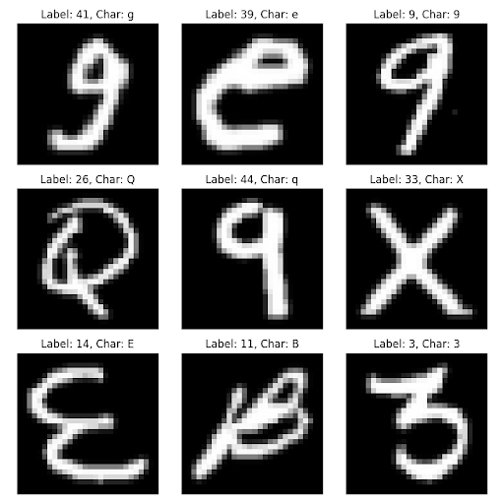
DATASET USED
- Balanced EMNIST dataset
- Number of classes: 47
- Training set size: 112,800
- Test set size: 18,800

Slide 5
02
METHODOLOGY

Slide 6
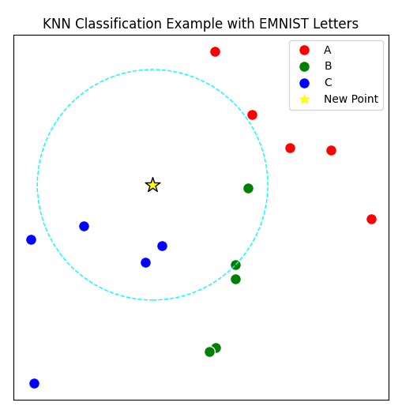
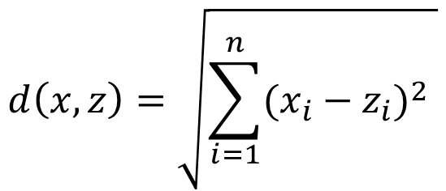
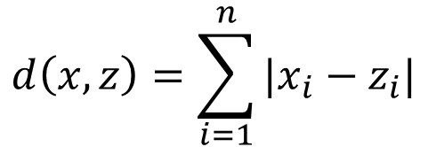
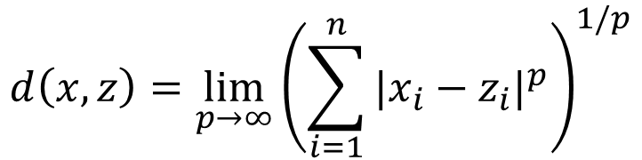
1. K-NEAREST NEIGHBORS
- K = 1/3/5/7/9/15
- Distance types used:
Euclid:
Manhattan:
Chebyshev:

Slide 7
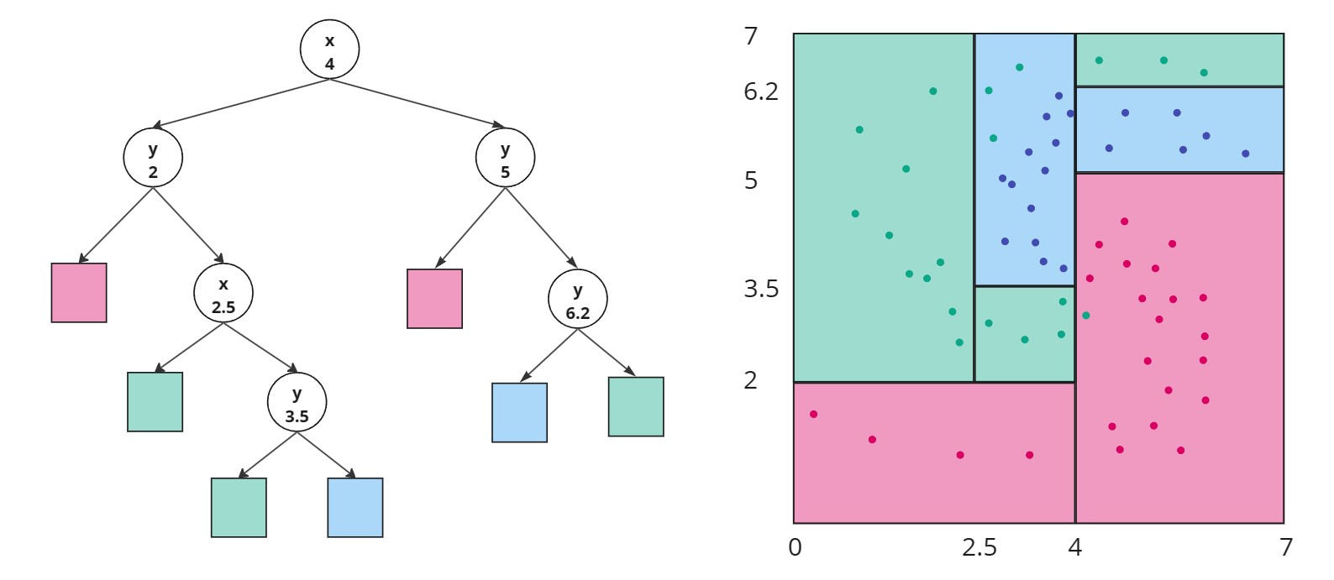
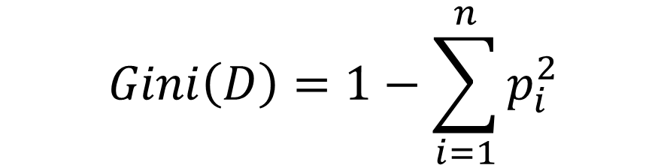
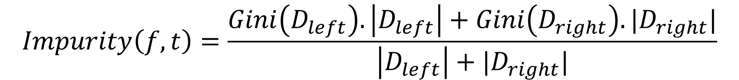
2. DECISION TREE
- Binary Decision Tree
- Split evaluation: Gini impurity:

Slide 8
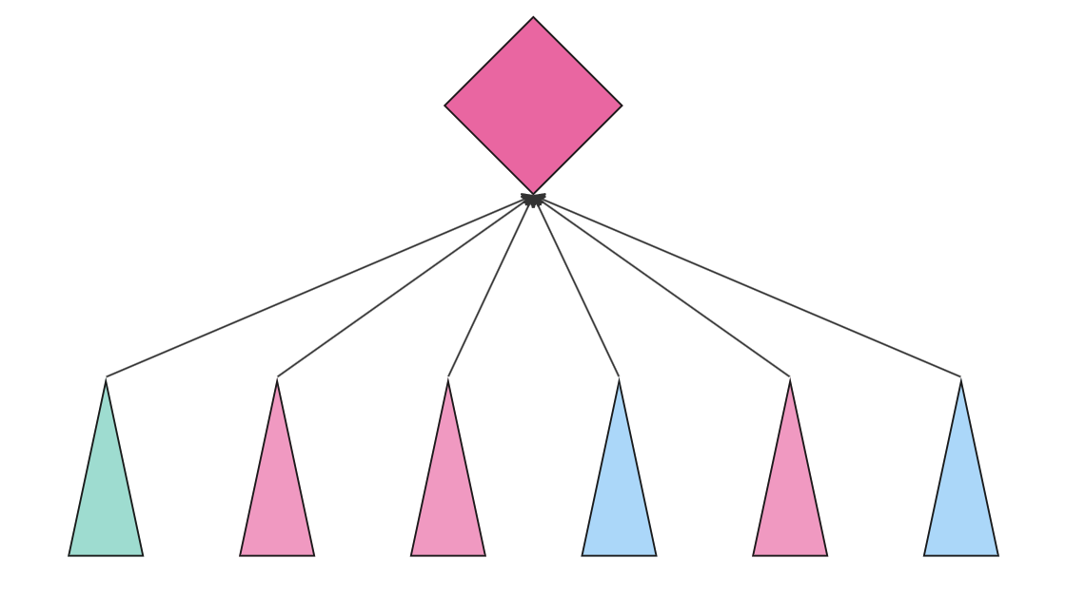
3. RANDOM FOREST
- Combine results of multiple decision trees which are built using random generated dataset by bootstrapping algorithm..

Slide 9
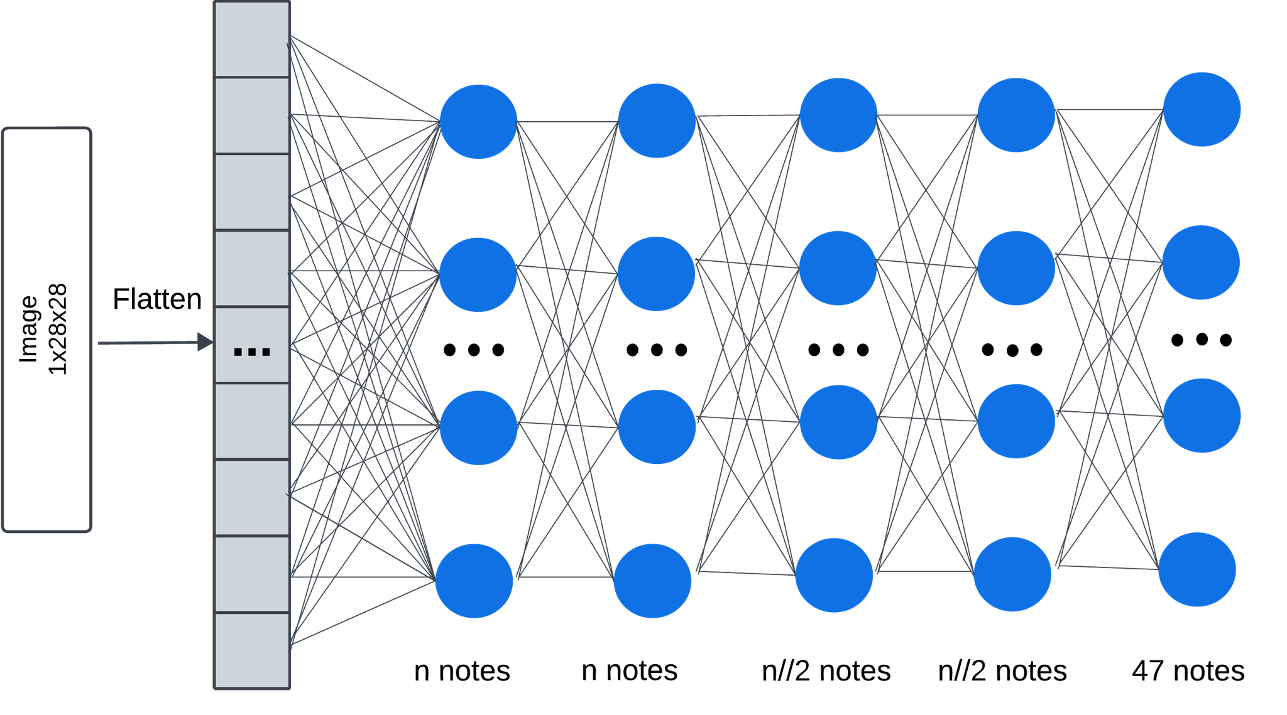
4. FEED-FORWARD NEURAL NETWORK
- Hidden layers: 4
- Activation: ReLU
- Dropout: 0.5 in Layer 1, 2
0.3 in Layer 3, 4
- Hidden units (n): 128/256/512
- Loss Function: Cross Entropy Loss
- Optimizer: Stochastic Gradient Descent

Slide 10
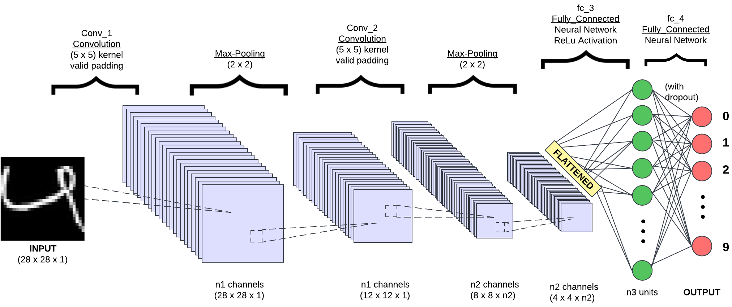
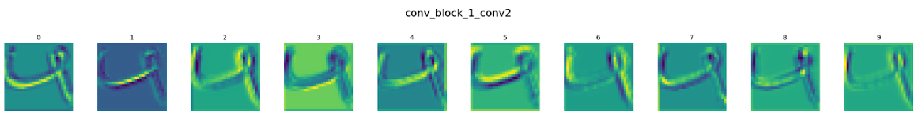
5. CONVOLUTIONAL NEURAL NETWORK

Slide 11
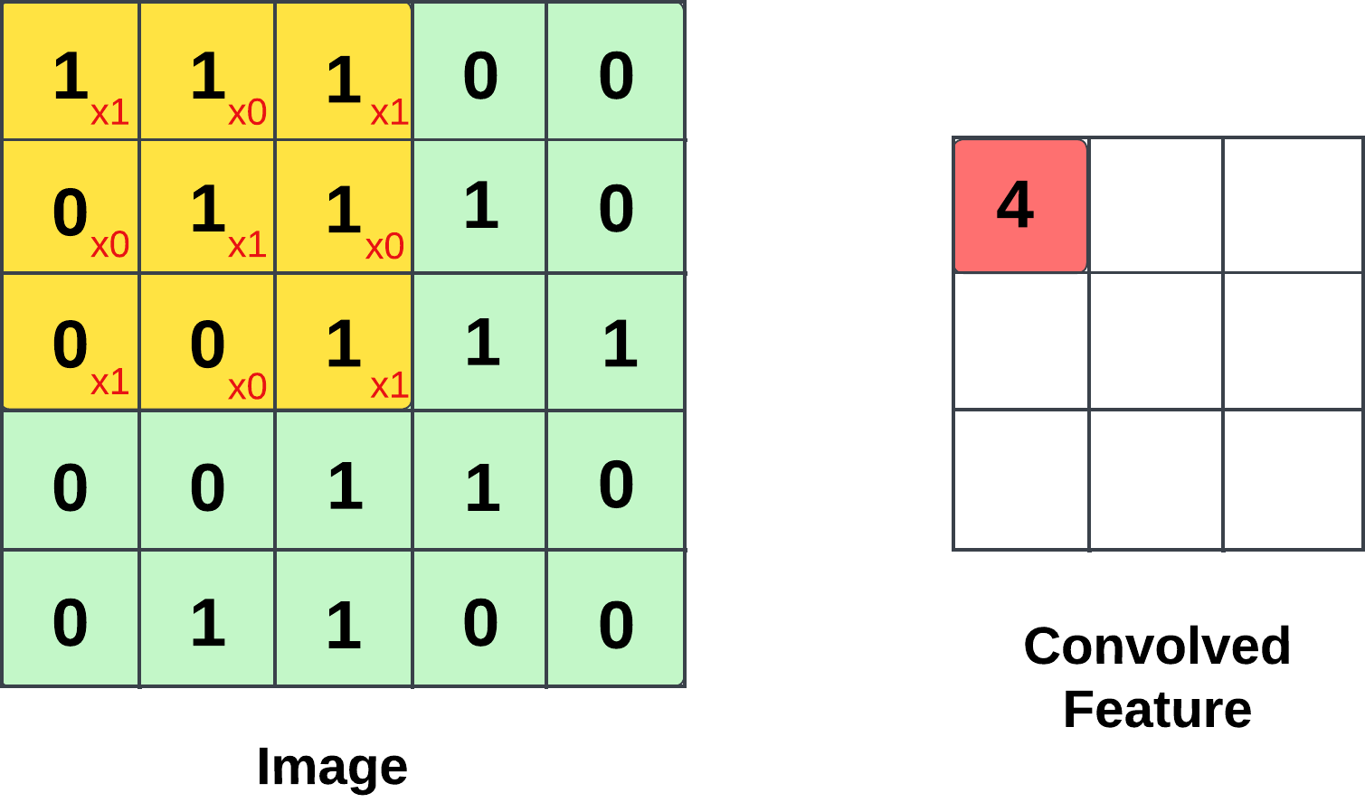
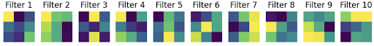
5. CONVOLUTIONAL NEURAL NETWORK
Filter/Kernel:

Slide 12
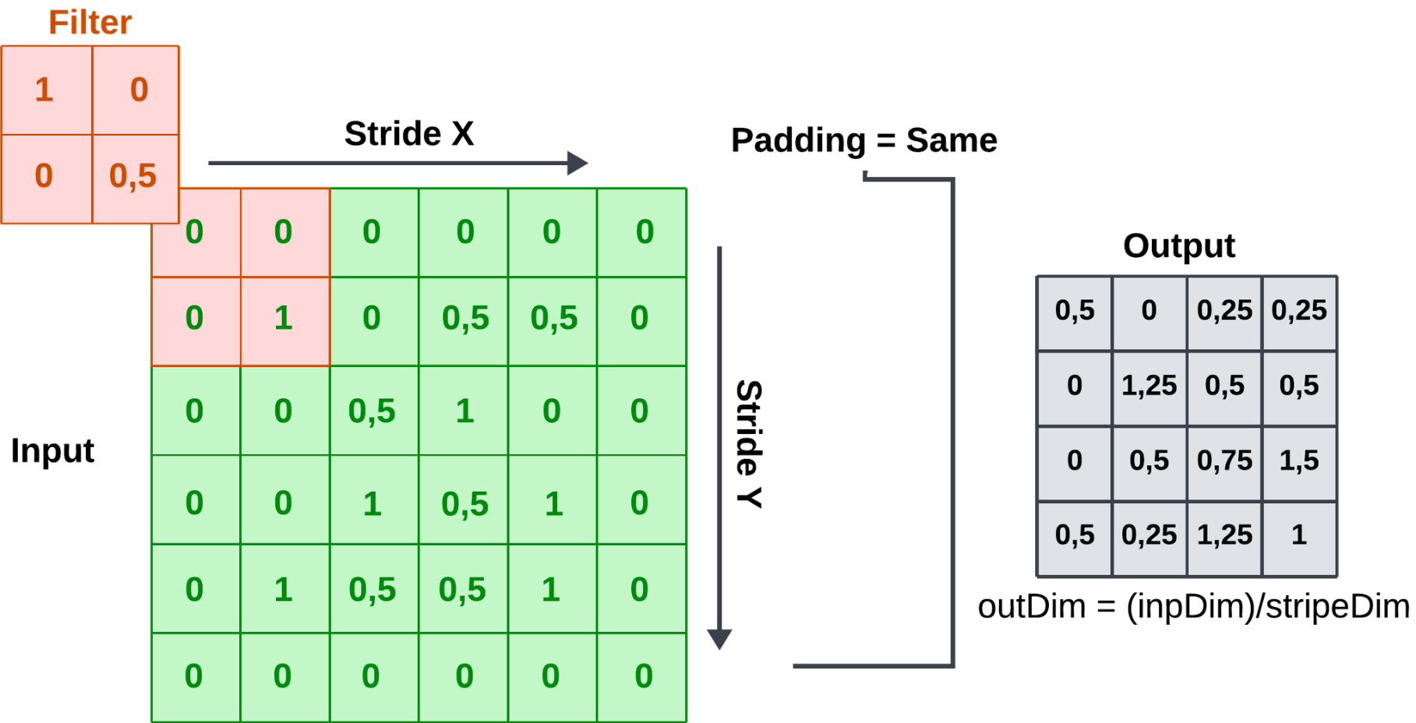
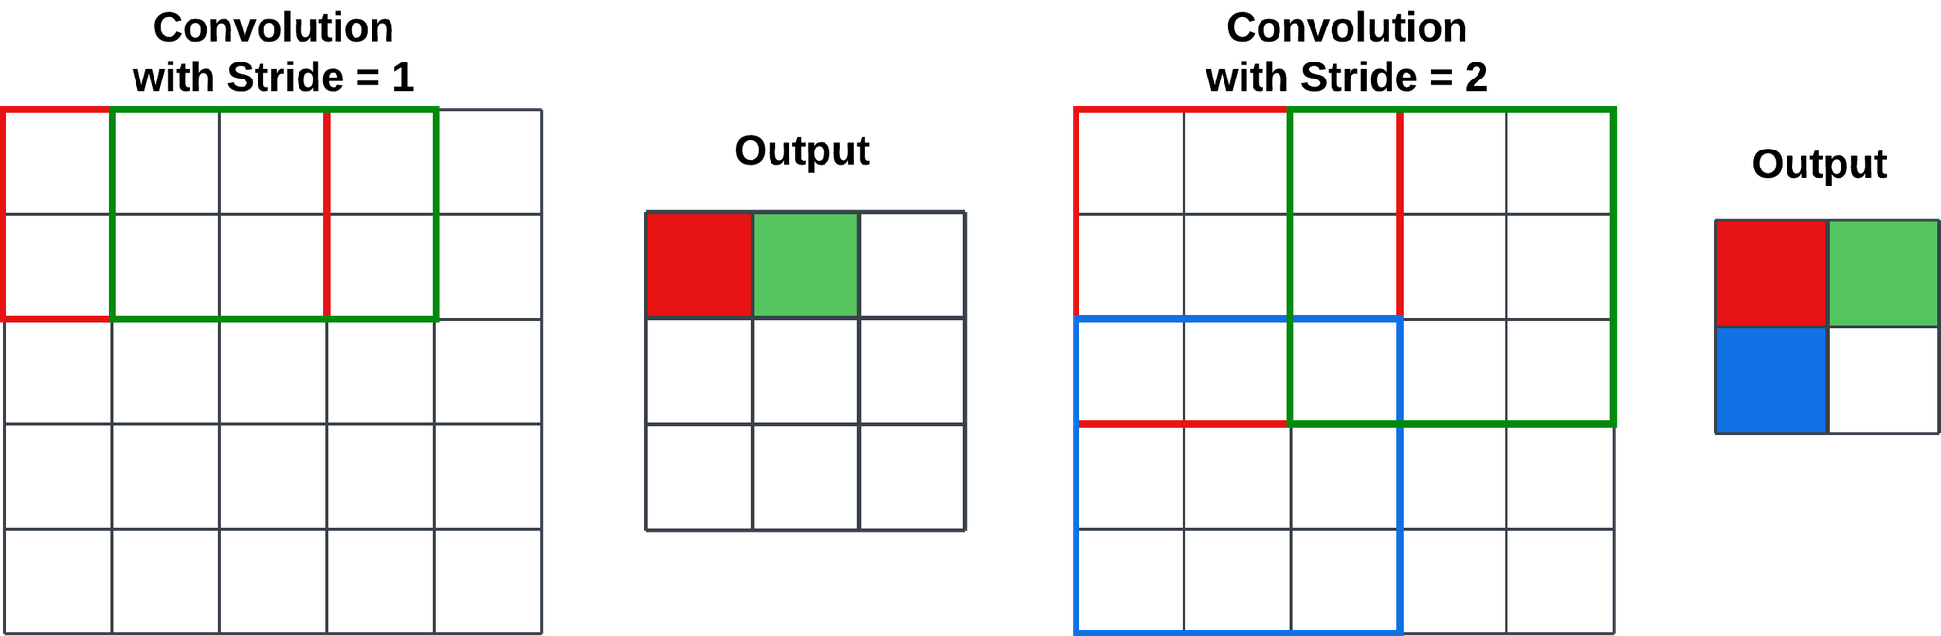
5. CONVOLUTIONAL NEURAL NETWORK
Padding:
Stride:

Slide 13
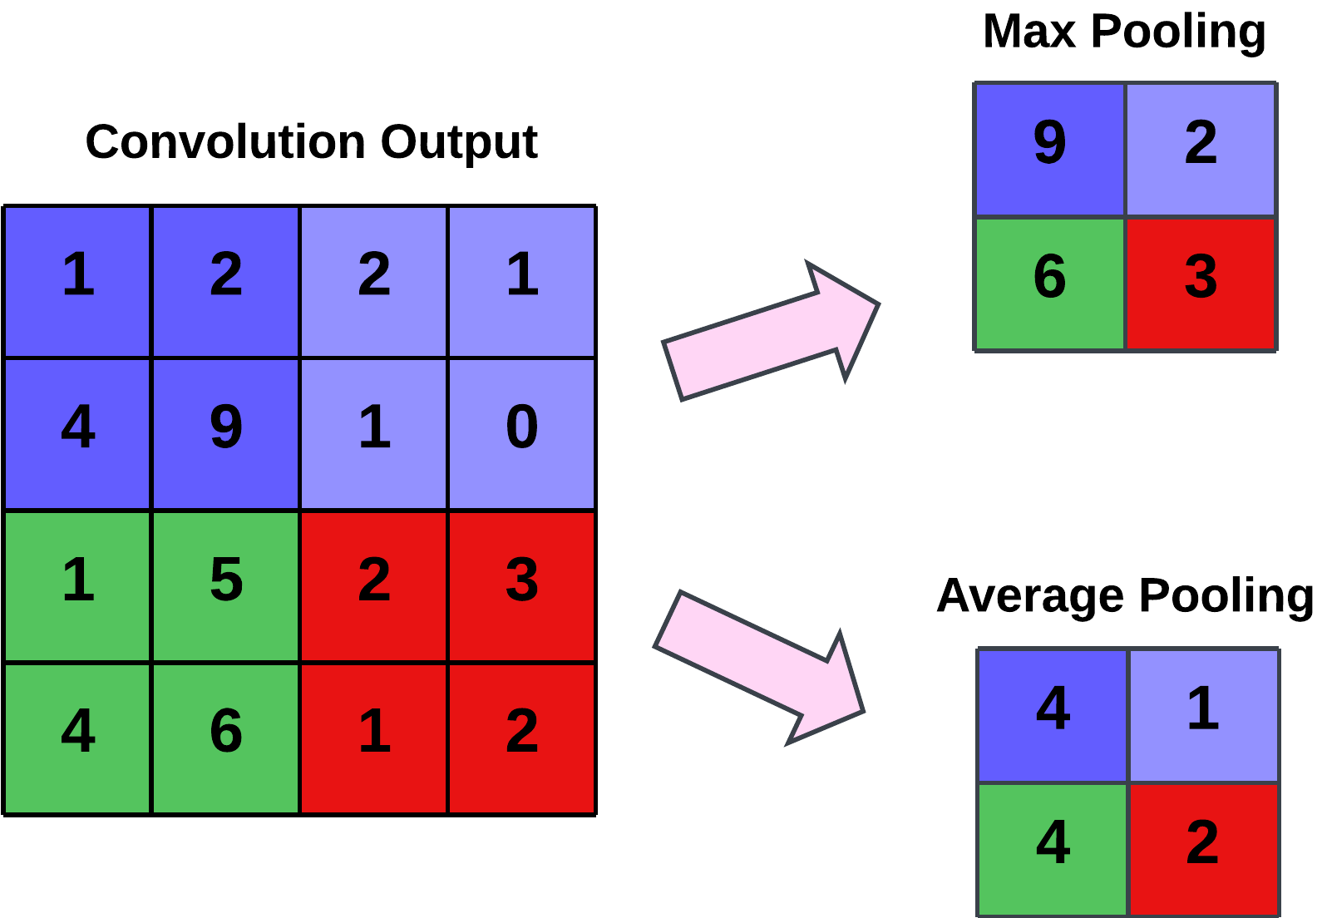
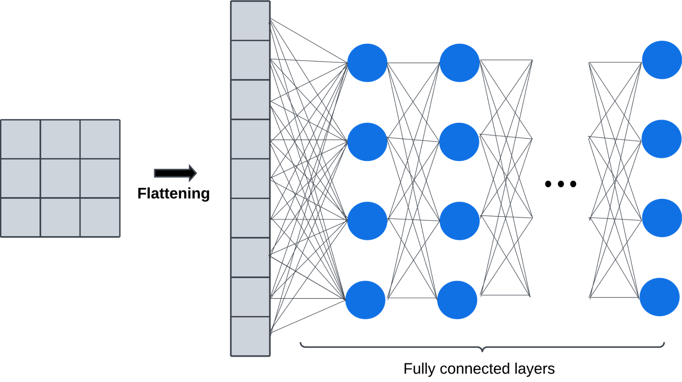
5. CONVOLUTIONAL NEURAL NETWORK
Pooling Layer:
Fully connected layer:

Slide 14
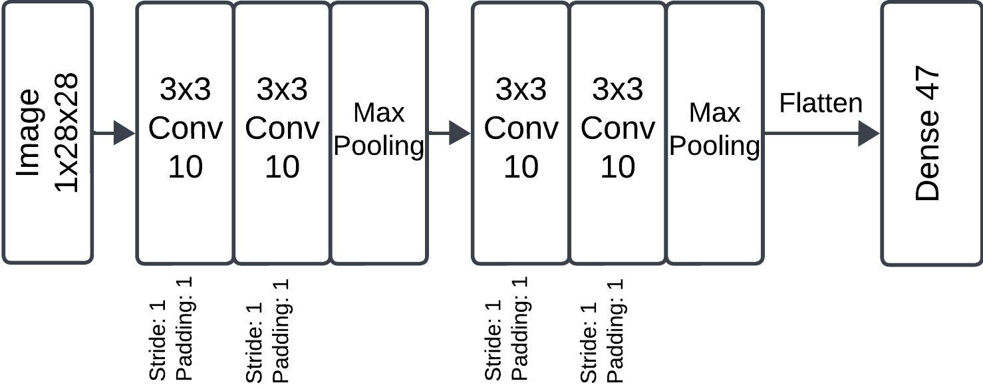
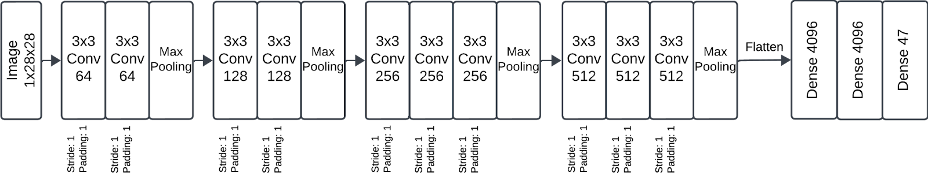
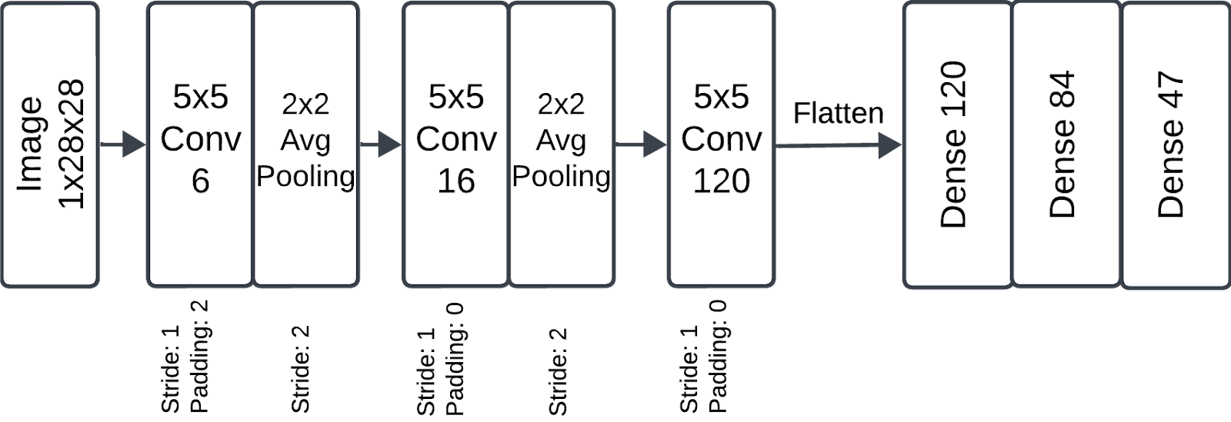
5. CONVOLUTIONAL NEURAL NETWORK
Simple CNN:
VGG-16:
LeNET:

Slide 15
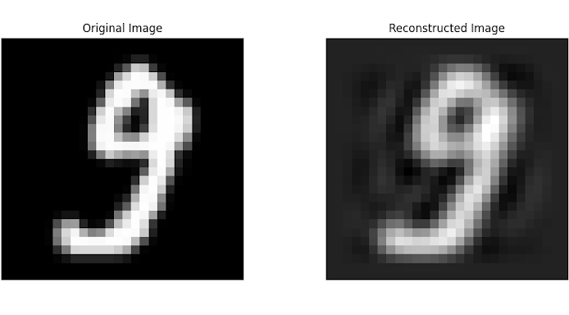
6. PRINCIPAL COMPONENT ANALYSIS
- Number of principal components: 50 - Percentage of original information preserved: ~85%

Slide 16
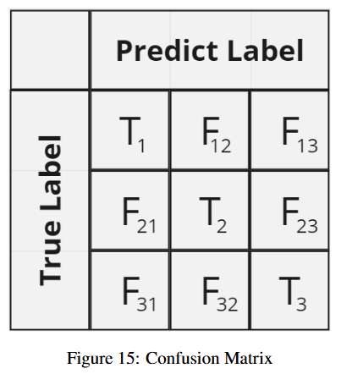
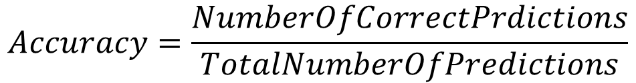
7. MODEL EVALUATION
Accuracy Computation:
Confusion Matrix:

Slide 17
03
RESULT

Slide 18
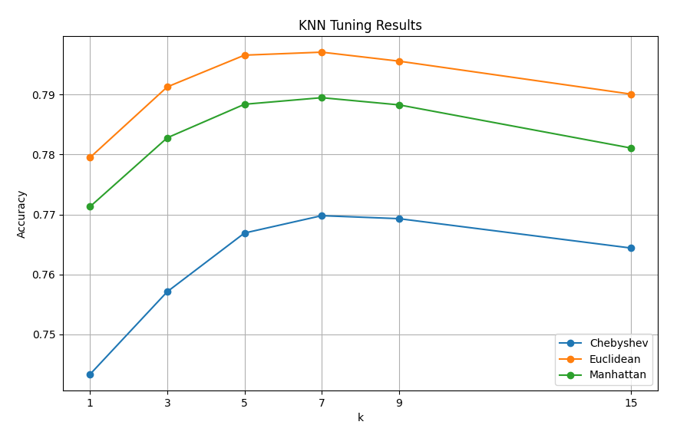
1. K-NEAREST NEIGHBORS

Slide 19
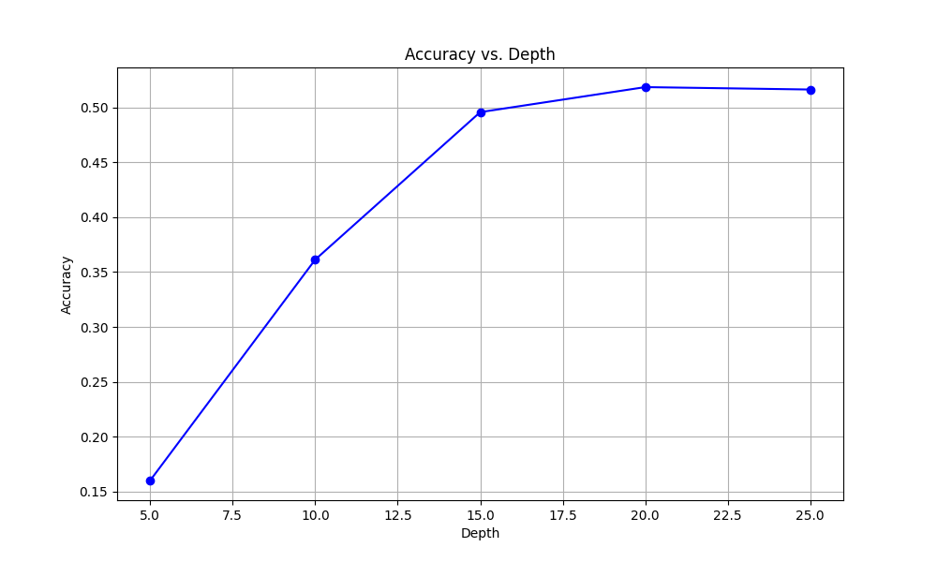
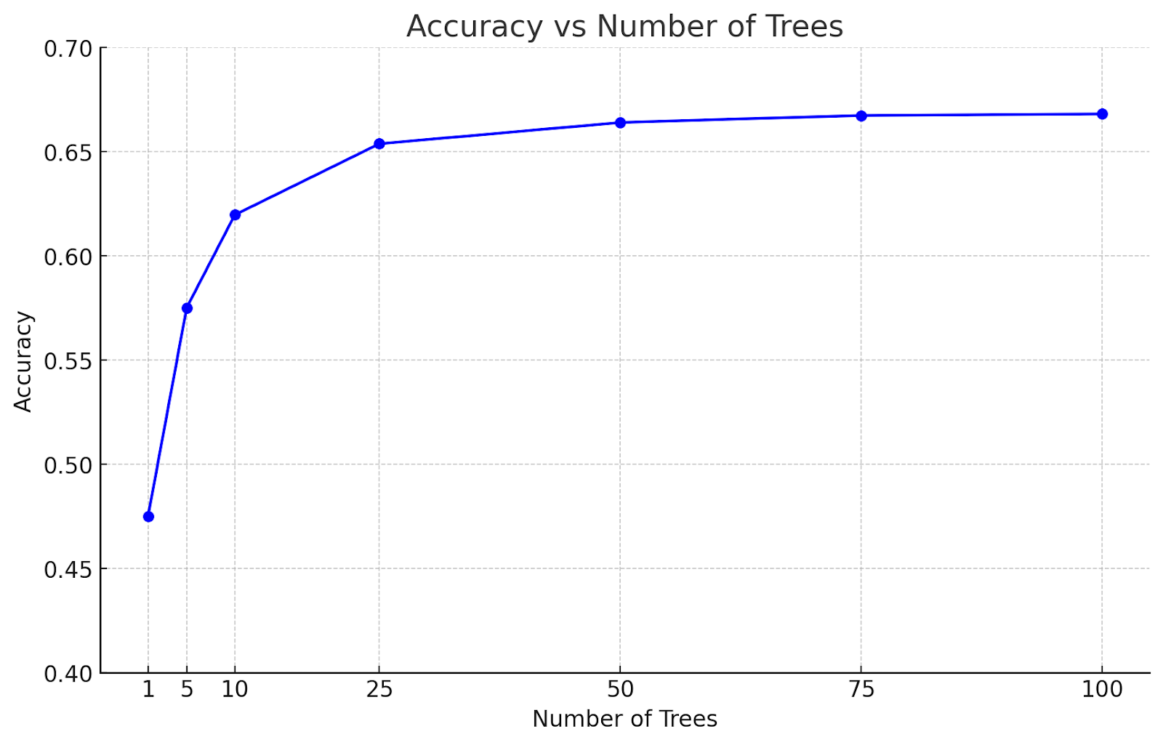
2. RANDOM FOREST

Slide 20
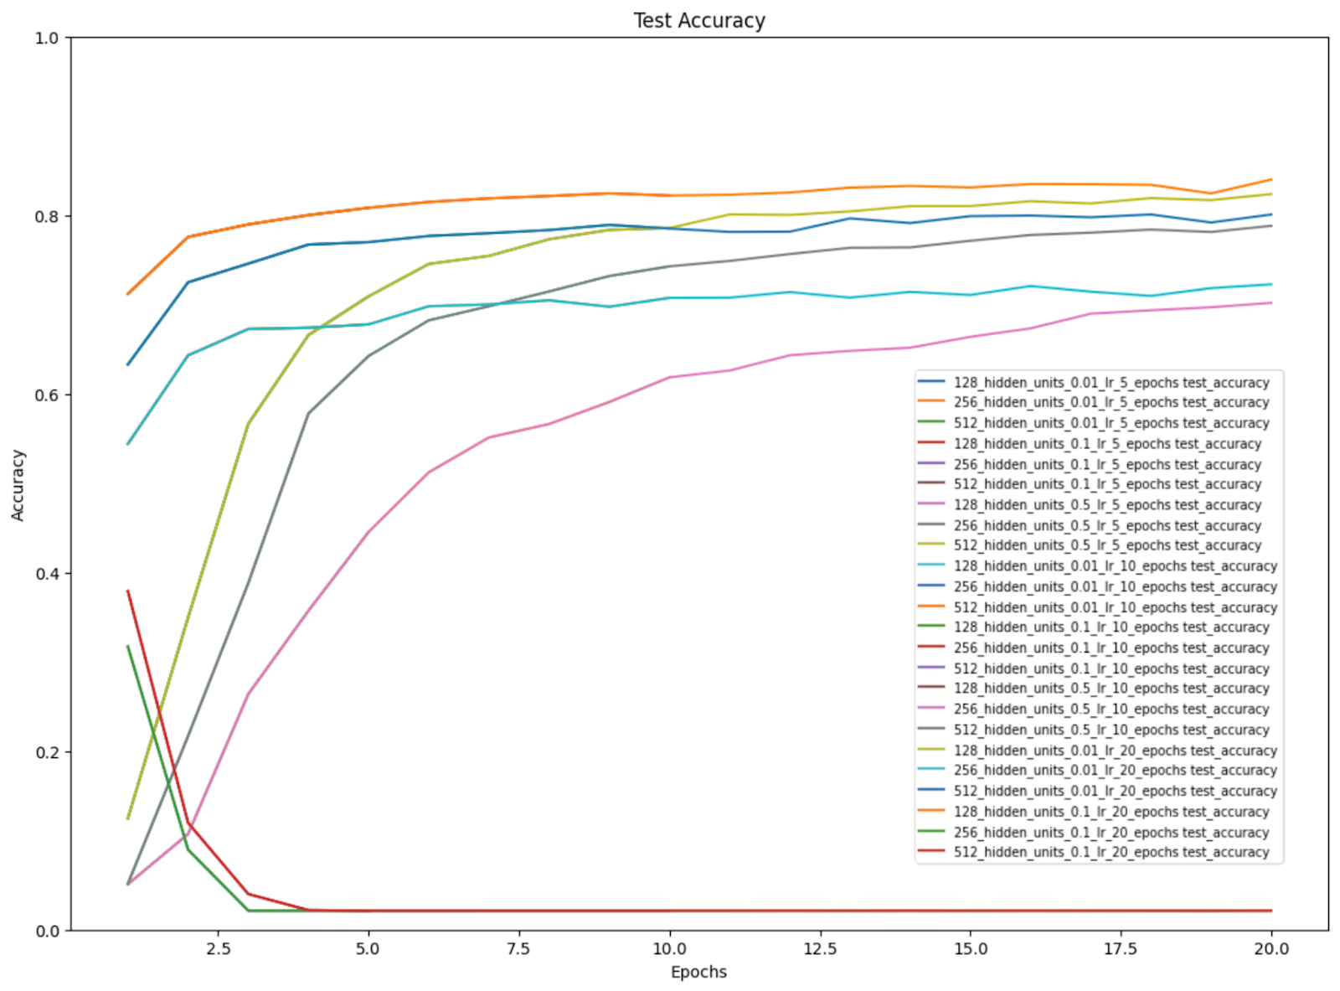
3. FEED-FORWARD NEURAL NETWORK

Slide 21
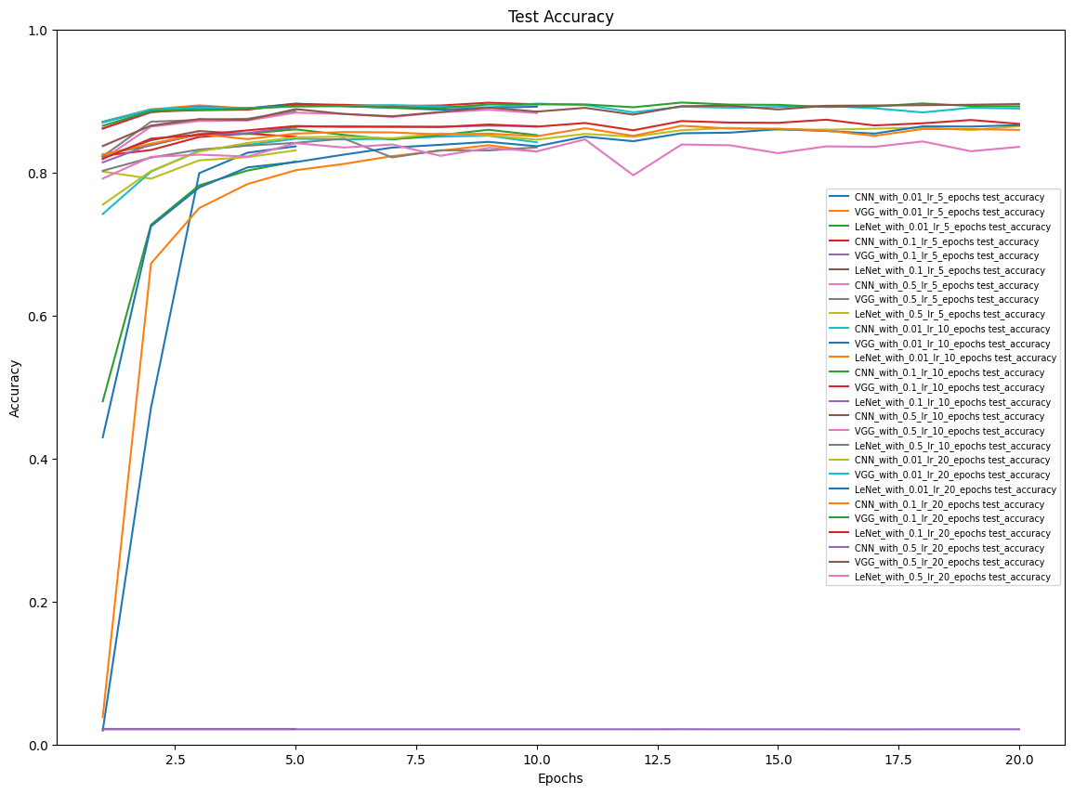
4. CONVOLUTIONAL NEURAL NETWORK

Slide 22
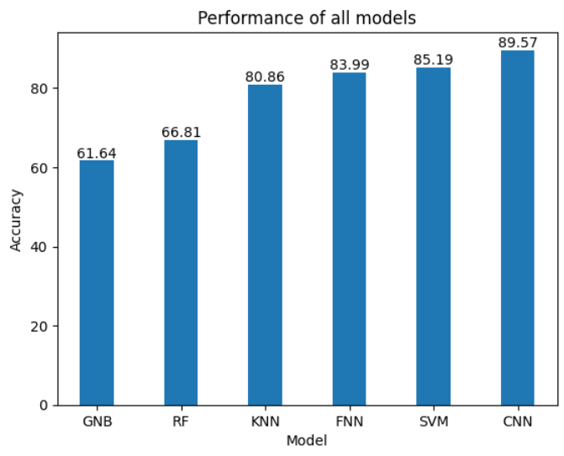
5. COMPARISON - ACCURACY

Slide 23
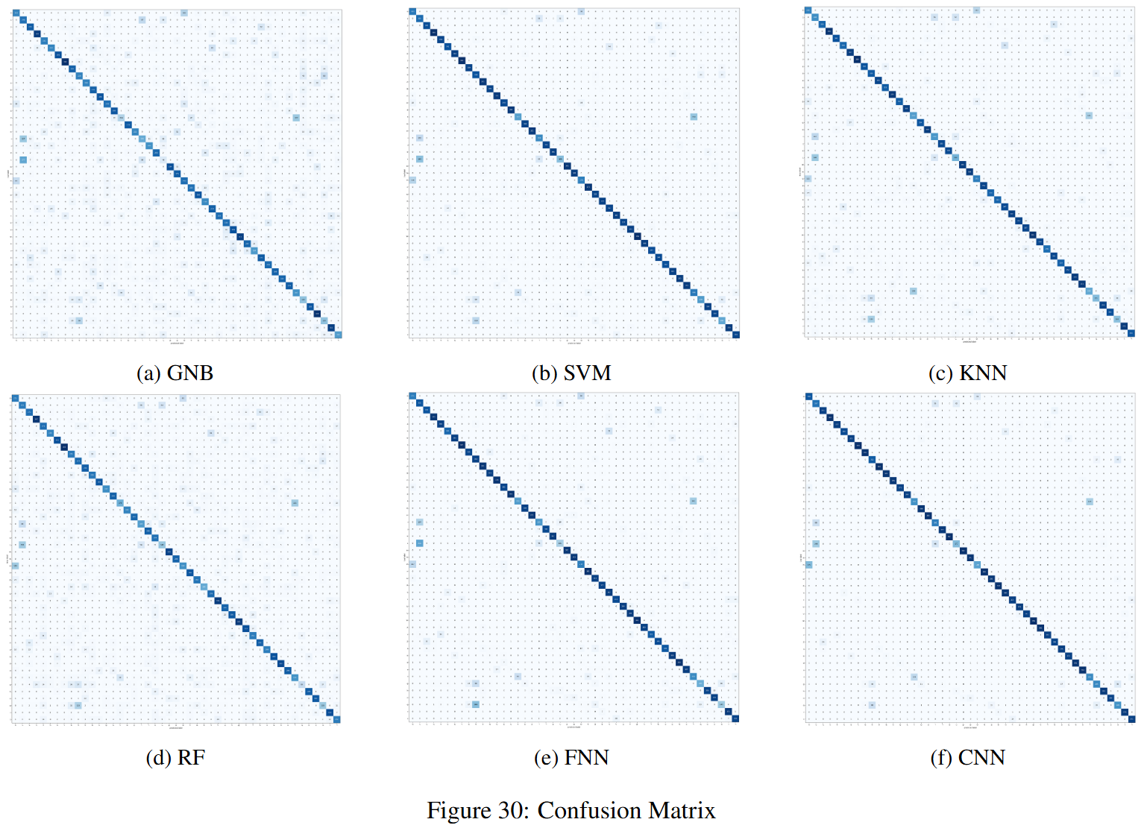
6. COMPARISON – CONFUSION MATRIX

Slide 24
04
CONCLUSION

Slide 25
THANK YOU

